Slide 1
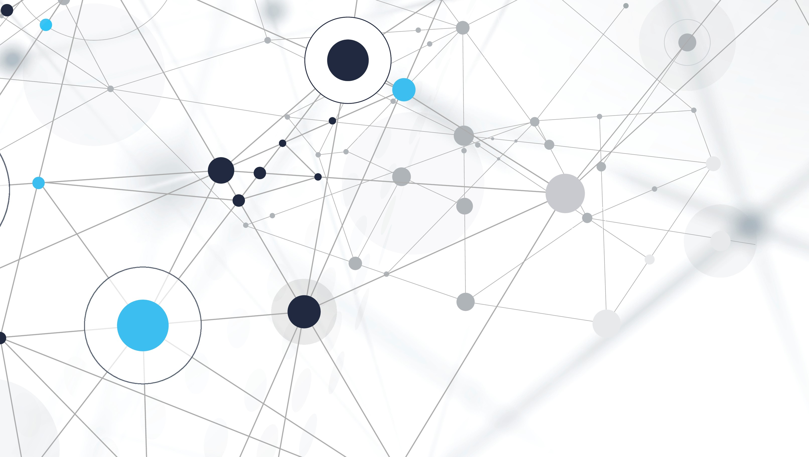
Virtual Mouse Using Deep Learning
Presented to: Dr. Mohammad Aoude
Presented by: Mohammad Sharara

Slide 2

Introduction
The idea is to use the webcam or any camera to detect the hand
Then, track it and be able to control the mouse pointer with it.
This is done using Deep learning.

Slide 3
Technologies used
Using Python, the code was implemented on Pycharm IDE.
The libraires used are:
Open Cv: to capture video frames and extract data from it
Math: helped in calculating the coordinates of the detected object
Time: to adjust the frame rate of the video
Autopy: GUI automation to control the mouse pointer of the computer
Numpy for easier and faster manipulation of n-dimentional arrays
Media pipe library

Slide 4

Mediapipe
A framework written by Google that implements deep neural networks for computer vision.
Can be used to detect iris, hands, body pose, face,…
The detection is in real time, and is of high fidelity.

Slide 5

Hand detection
From a single frame, Mediapipe is able to detect 21-3D key points of the hand called ‘landmarks’.

Slide 6
Hand detection (cont’d)
The model used ~30000 real 3D images with 21 coordinates to train the model.
Also, a high-quality synthetic hand model was rendered over various backgrounds and mapped to the corresponding 3D coordinates.
An accuracy of 95.7% was achieved, compared to 86.22% for previous models
Convolutional Neural Networks (CNN) were used.

Slide 7
Cnn
CNN’s reduces the images into a form which is easier to process,
without losing features which are critical for
getting a good prediction.
Thus, a filter/Kernel is applied to the image
to extract important high-level features before
feeding the data to feed forward network.

Slide 8
CNN (cont’d)
Similar to the Convolutional Layer, the Pooling layer is responsible for reducing the spatial size of the Convolved Feature. This is to decrease the computational power required to process the data.

Slide 9
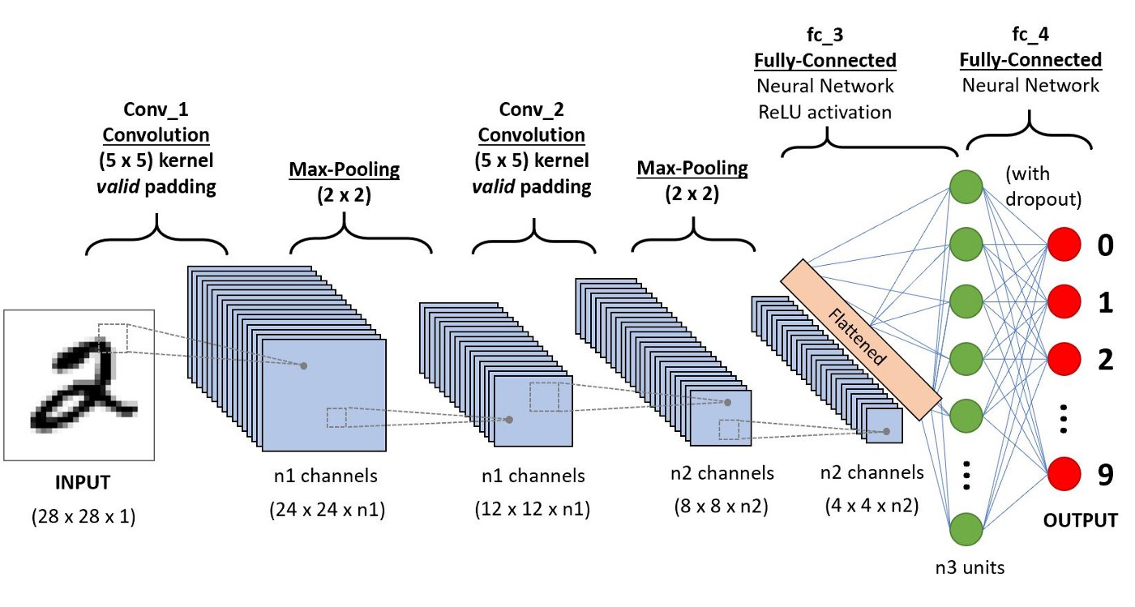
Cnn (cont’d)
The data is then flattened and fed into a feed-forward
fully connected neural network.

Slide 10
Implementation
The code was implemented and tested on a webcam laptop.
The results where great and of high accuracy given the quality of the webcam.
More adjustments could be done to improve the smoothness of pointer movement, and to fix shortages on the boundary of the picture.

Slide 11
THE END
Thanks for your time

